Slide 1

Managing Technical Debt in Space.

Slide 2
Managing Preventing Technical Debt in Space.

Slide 3
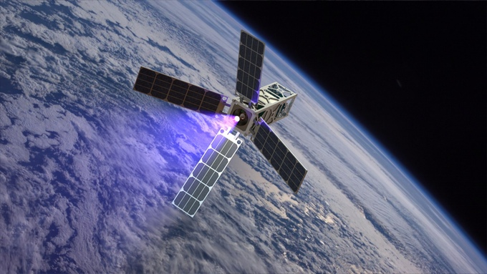


Writing Deep Space Exploration Software for Raspberry PI CAT CubeSats

Slide 4
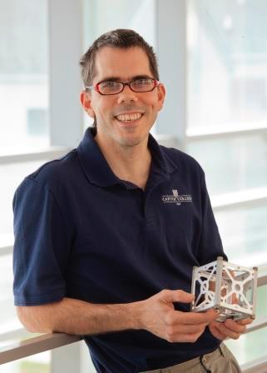
Inspired by Dr. Sandy Antunes
Project Calliope
Notes:
pico-satellite to capture earth’s music

Slide 5
{breathe}

Slide 6
What?
Managing Technical Debt in Space
Brief History of Space Software Development
Technical Debt
Old vs. Modern DevOps
Future Quantum Solutions
/ Tables Text

Slide 7
Who?
Managing Technical Debt in Space
Those building CubSat and Pico Satellite Software
Helping ensure your CubSat doesn’t go b00m because of software
College Under/Graduates looking to get into the Software & DevOps game
Anyone sending Arduino, Raspberry PI, and Cylon.js to space
/ Tables Text

Slide 8


Legacy for the Next Generation
Get girls in STEM.
Sydney
Rowan
?
Reader.
Tinkerer.
… work in progress…
READING
TINKERING
???
80%
50%
LIKE HER MOTHER
LIKE HER MOTHER
LIKE HER MOTHER
75%
10%
DEAR GOD LIKE ME
DEAR GOD LIKE ME
DEAR GOD NOT LIKE ME
25%
90%
Notes:
girls in stem
learn failure
learn hard work

Slide 9
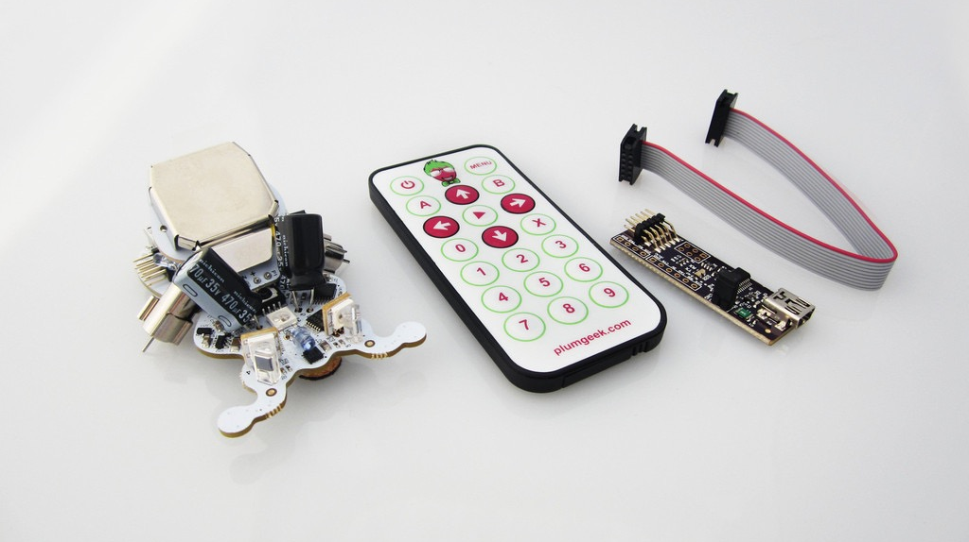
Notes:
experiemnt

Slide 10
Brief Space Software Dev History
Failures & Successes
Notes:
Margaret Hamilton of Apollo 11
Mars Climate Orbiter
Saturn V
Ariane 4 & 5
Space Shuttle

Slide 11
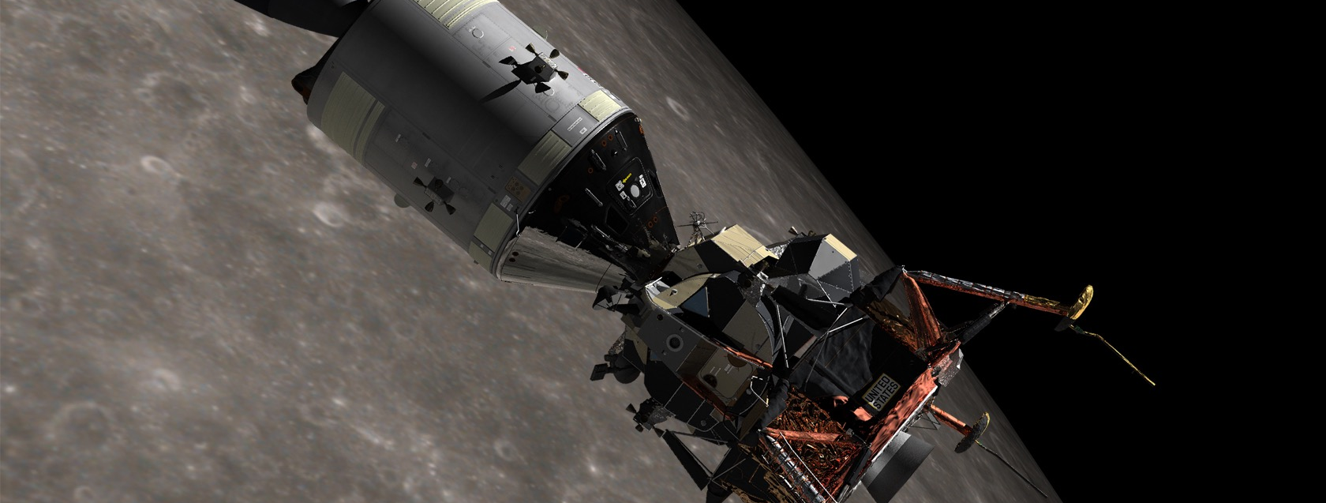
Apollo 11
Put first humans on the moon.

Slide 12
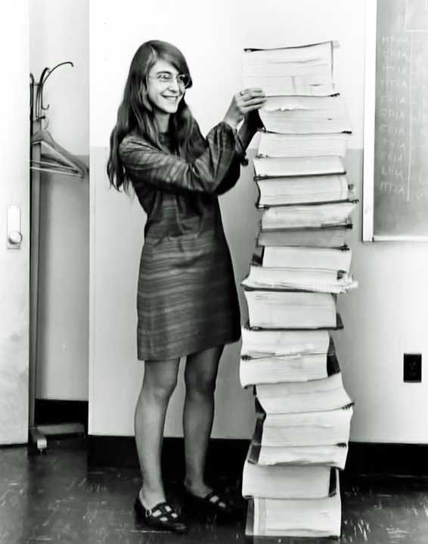
Margaret Hamilton
Director of software programming for Apollo & Skylab
Notes:
software engineering
parallel computing
priority scheduling
end to end testing
Lesson: Leadership Support for Great Engineering, Brilliant Engineers can create fault tolerant systems

Slide 13
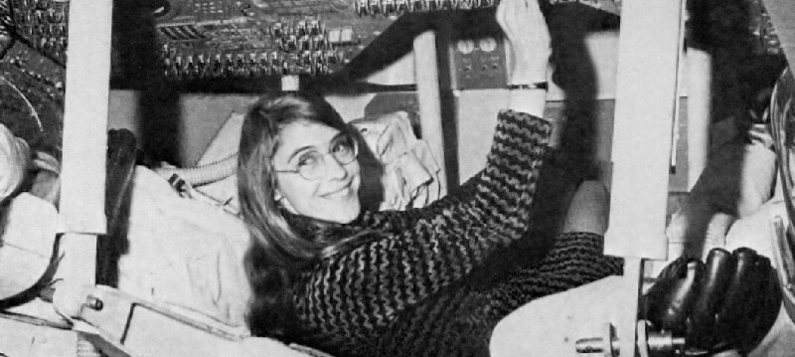
Apollo Guidance Computer
/ Our Work
Notes:
Used Assembly Code
Used Core Rope Memory (LOL Memory, Little Old Lady)
Used concurrency with priority in tasks
3 minutes before Lunar lander reached Moon’s surface, pahty alarm
rendezvous radar system switch wrong position, too much data
Lesson: Leadership Support for Great Engineering, Brilliant Engineers can create fault tolerant systems

Slide 14
{breathe}

Slide 15
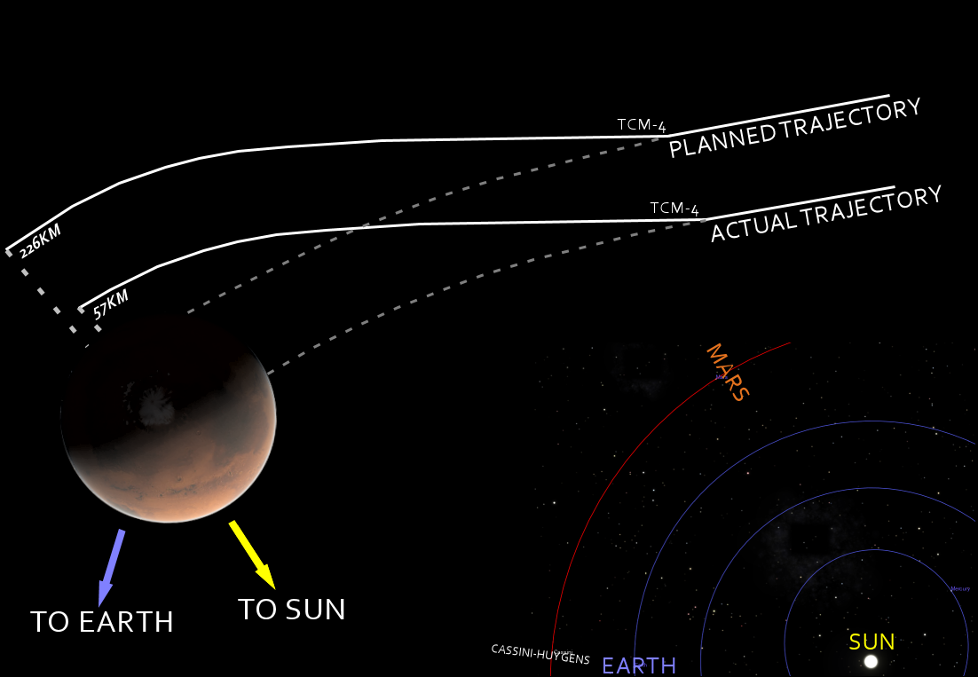

Mars Climate Orbiter
Study Martian climate, atmosphere, and surface.
Notes:
went too close to Mars and disintegrated in the atmosphere
NASA specified newton-seconds (N s), Lockheed used pound-second (lb s)
Ground issued thruster firings, put it too close to Mars’ surface
2 navigators noticed earlier, but their concerns were dismissed
even had a meeting to fix it, but didn’t end up doing it
Mars Global Surveyor had conversion correctly, but algorithm was too complex (or not commented enough) to read, so new code didn't include conversion
Lesson: MOAR UNIT TESTS!!!11oneone

Slide 16
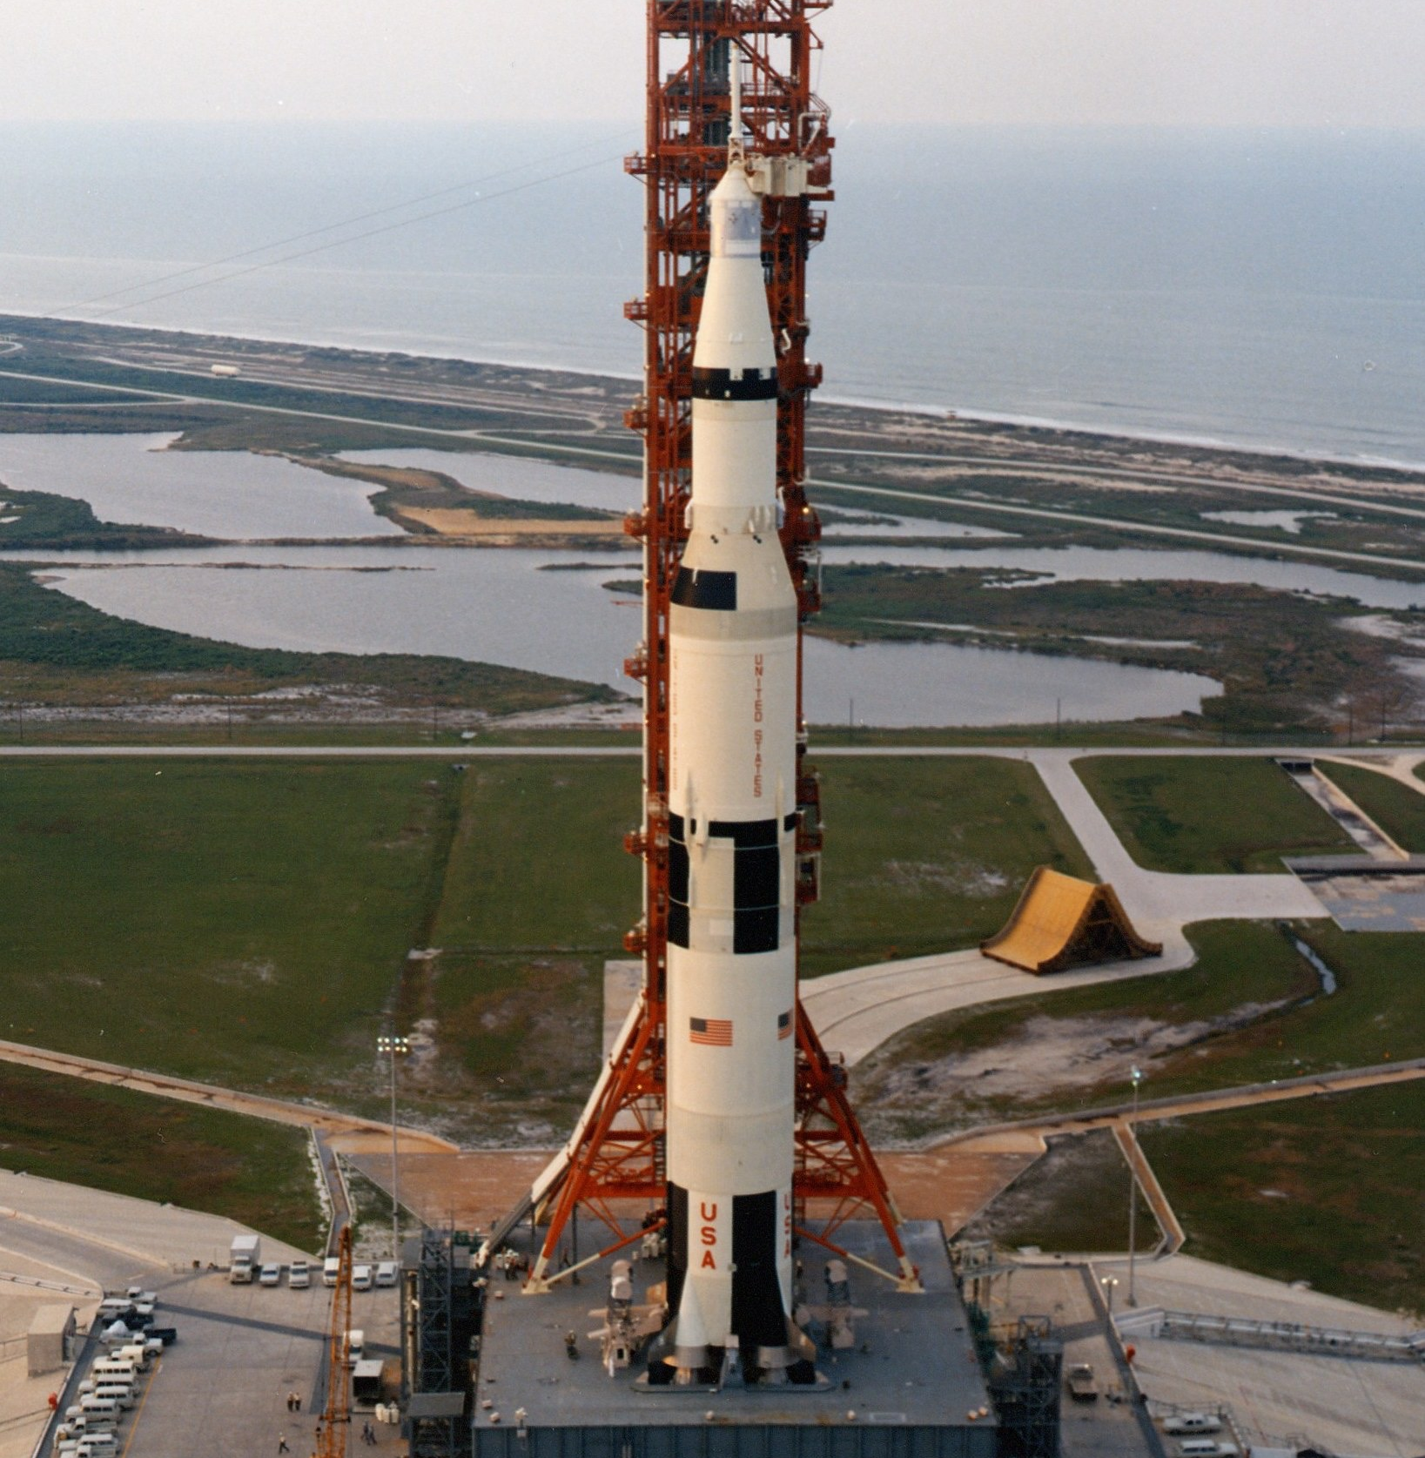
Saturn V
Notes:
George Mueller, NASA Admin during Apollo
“you don't want to be testing piece-wise in space. You want to test the entire system because who knows which one's going to fail, and you'd better have it all together so that whatever fails, you have a reasonable chance of finding the real failure mode, not just the one you were looking for.”
Carried Astronauts around the moon on its 3rd flight vs. 10th or later as originally planned.
Saved millions of dollars, years of development, and probably enabled us to win the space race
Lesson: Test Entire System as Soon as Possible

Slide 17
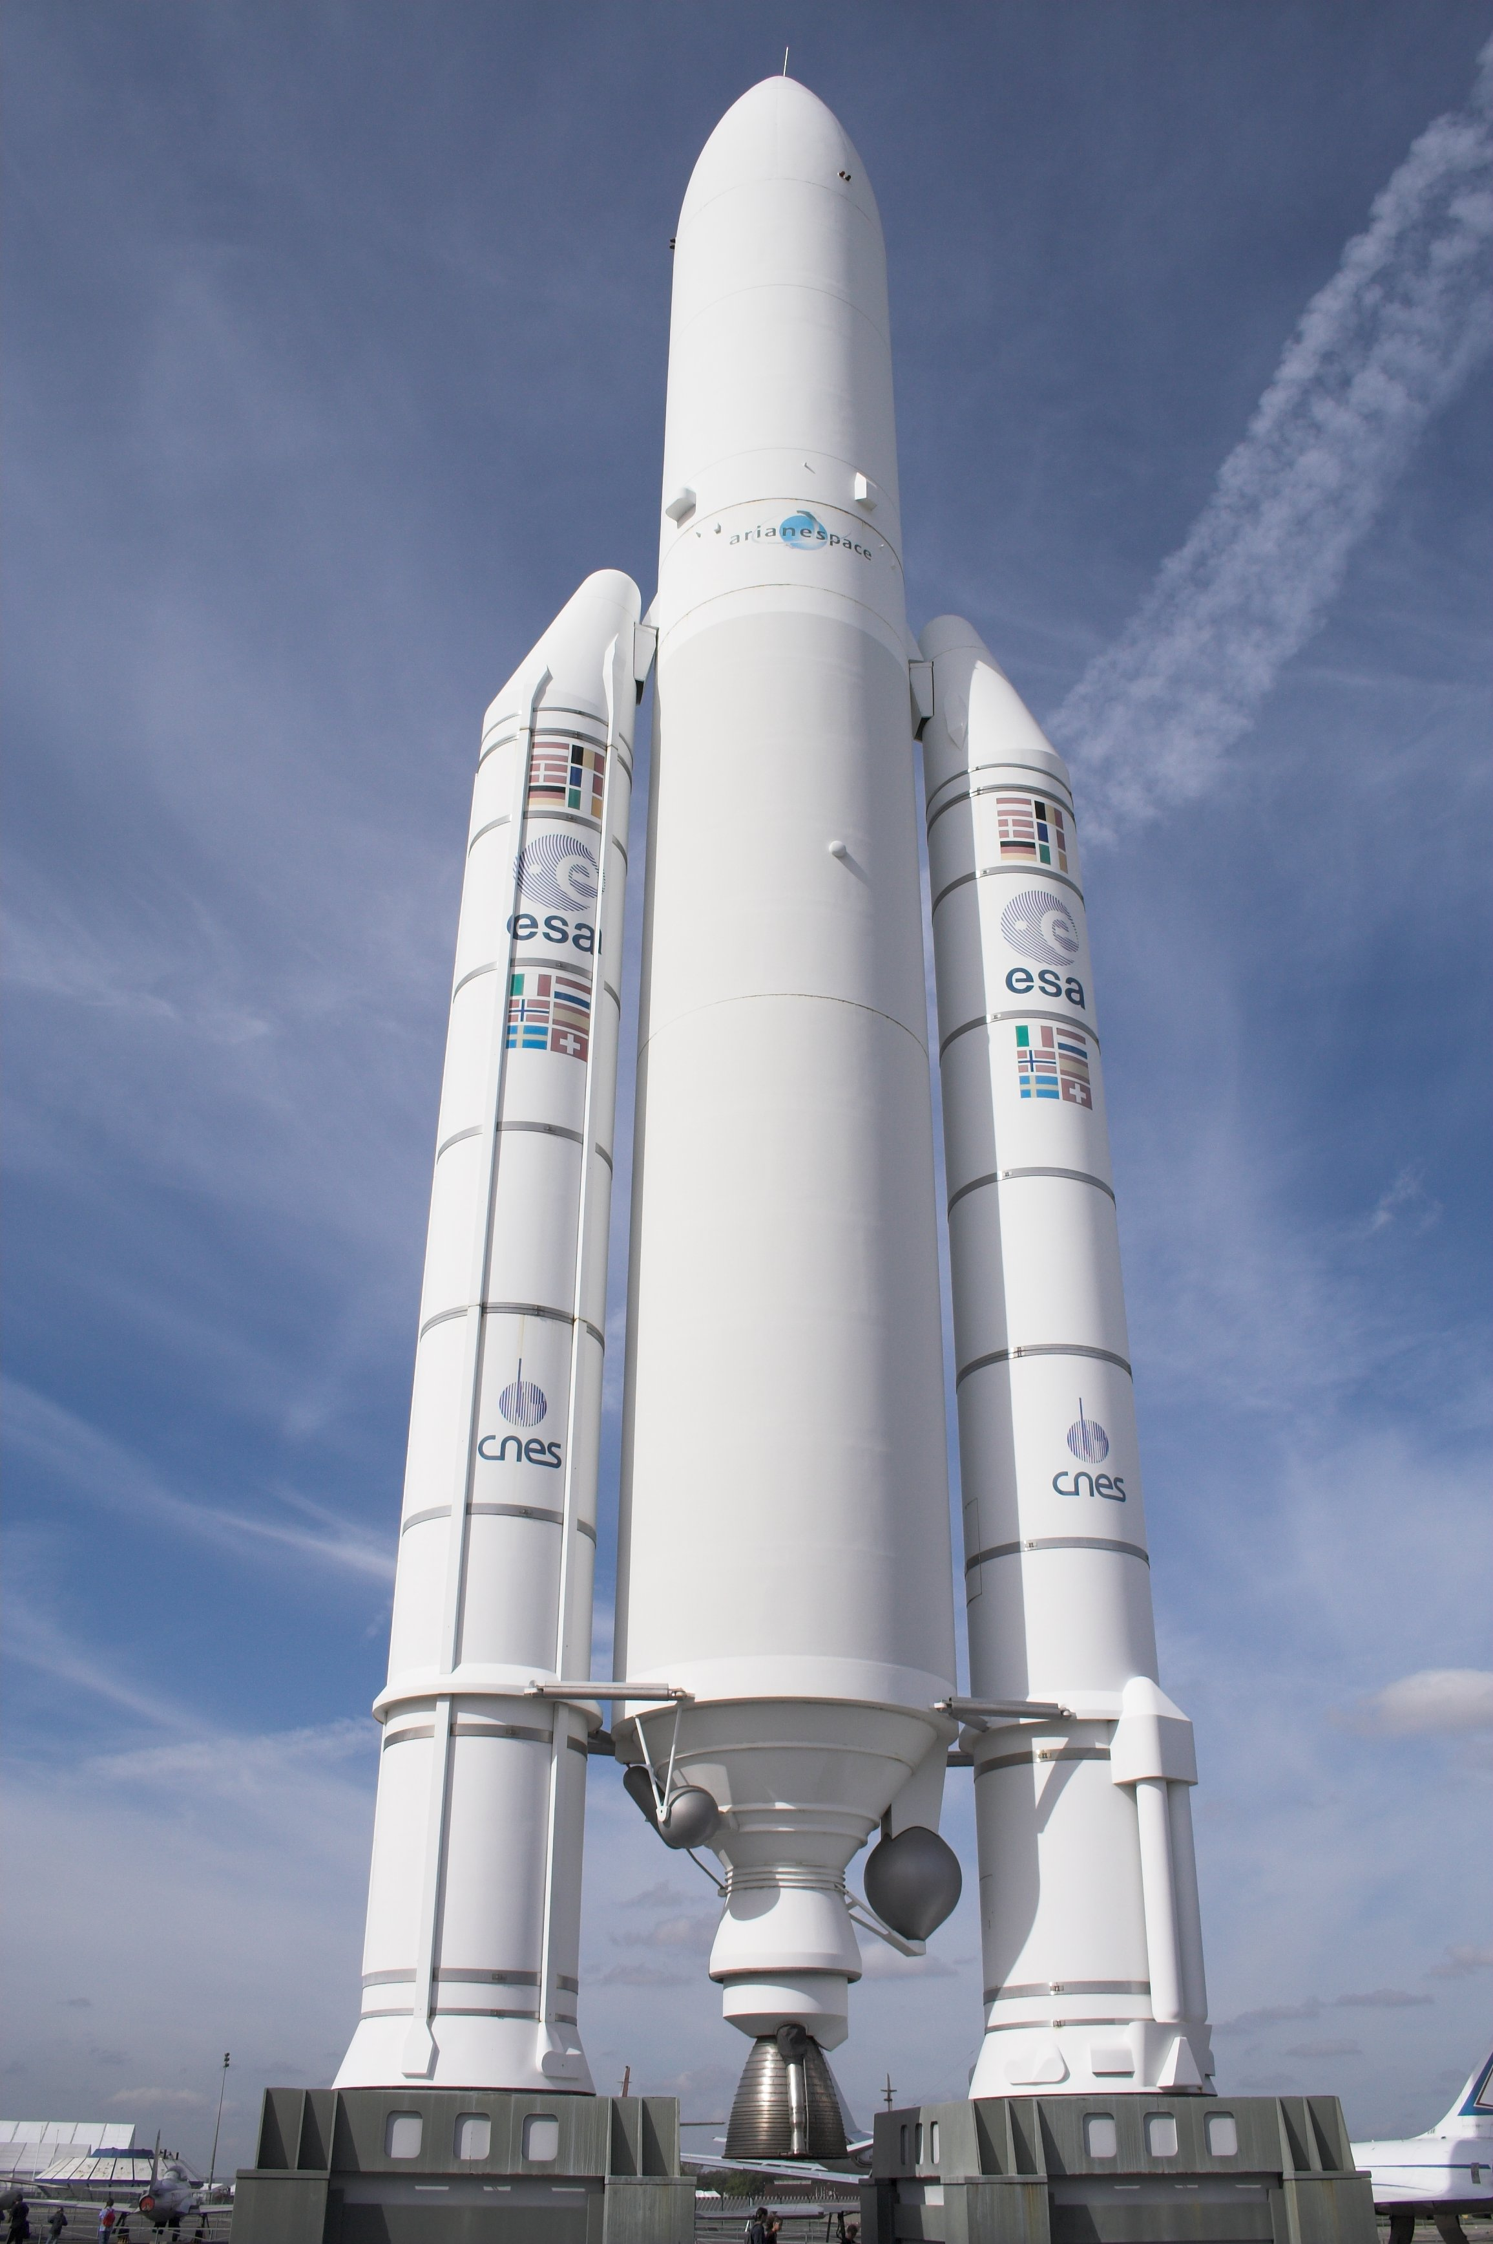
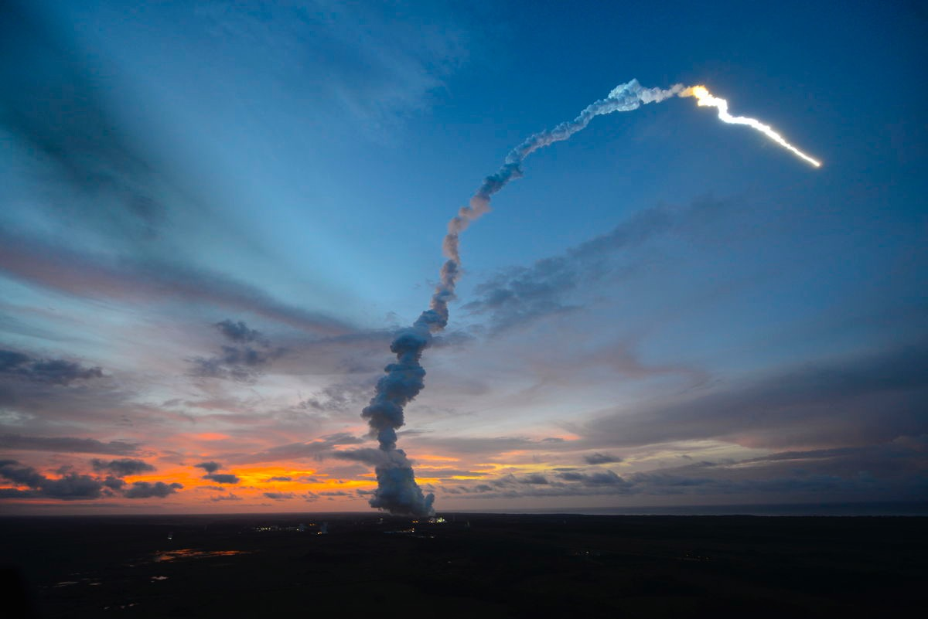
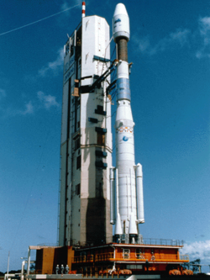
Ariane 4 and 5
Notes:
Maiden flight of launcher ended in failure
veered off course and went b00m
unhandled exception: converted a 64-bit integer to a 16-bit signed integer
caused primary & backup guidance systems to fail
unguided & out of control
code reused from Ariane 4
Ariane 5’s velocity MUCH higher
… velocity monitoring wasn’t needed.
Lesson: “If it ain’t broke, don’t fix it.” But you SHOULD re-test it.

Slide 18
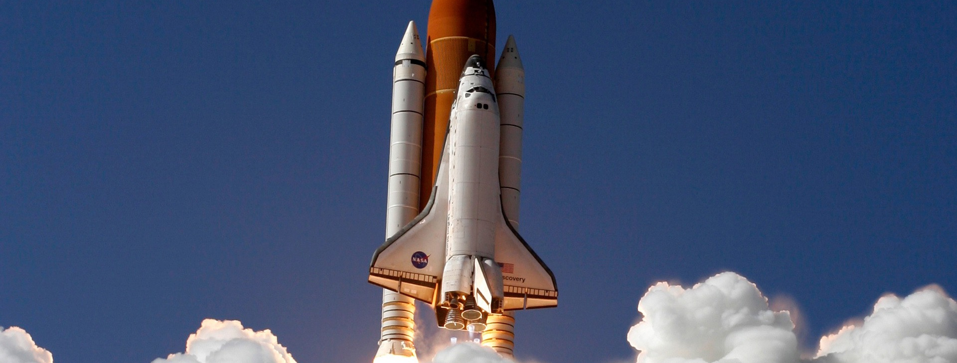
Space Shuttle
Notes:
before challenger: 2 weeks
after challenger: 18 months
1,000 unit tests for every line of code
code reviews to place certain lines of code next to each other in case of lightning strikes
constantly would run out of system resources running so many unit and end to end tests & complex test simulations
Lesson: After mission(s) over, you have EPIC fixture data to test with. Simulations are powerful testing tool.

Slide 19
{breathe}

Slide 20
Technical Debt
https://medium.com/@joaomilho/festina-lente-e29070811b84#.iuhs8io61

Slide 21
Debt With Interest
https://en.wikipedia.org/wiki/Ward_Cunningham
/ Charts Data
Notes:
Debt: Borrow or trade to get something now for a long term financial burden
Interest: Not just repaying what you borrow; incentive for the lender
Longer you wait to pay back, more interest
Ignore debt too long, you go bankrupt

Slide 22
Is Debt Bad?
Based on Niall Ferguson’s work
"credit drives innovative societies"
No trust & economical institutions in place == stagnation
5 months
Pay back loan in full
4 months
Lender gets interest on payments
3 months
First set of users pay costs
2 months
Build a SaaS
1 months
Take a Loan
/ Process
Notes:
Niall Ferguson says credit drives innovative societies
Buy a machine, immediately create with it, use results to pay back debt
No trust & economical institutions in place == stagnation

Slide 23
{breathe}

Slide 24
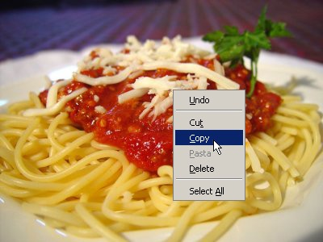
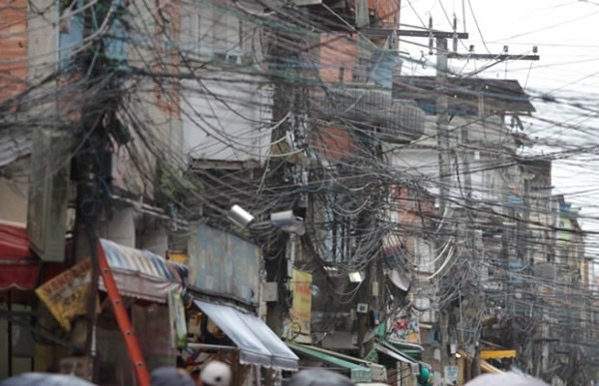
Metaphor for Non-Technical Managers
(picture of copy pasta & Brazil Favelas)
Notes:
If you don’t write software a good way w/biz understanding
… you incur technical debt
increases over time, like interest
“Spaghetti Code” or Architecture
Tightly Coupled
Brazil Favelas w/power grid

Slide 25
Why? It’s A Strategy.
Patton: “Any fool can make rash decisions; take calculated risks.”
Do users want to edit roles?
No clue, hardcode roles for each user.
Test with multiple, real users.
01
02
03
Release new version.
Remove hardcoded values, add custom
Users want ability to customize.
06
05
04
Notes:
Defer decision until you know more later
Patton: “Any fool can make rash decisions; take calculated risks.”
Defer good implementation to meet deadline
Refactoring: Doing it right with hindsight
Takes more time than to code it originally
Managers are cool w/it because they never engage w/consequences

Slide 26
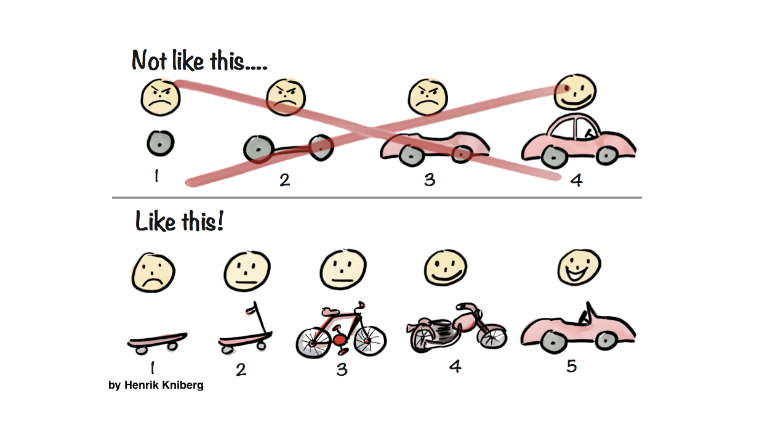
Notes:
LinkedIn’s founder Reid Hoffman “if you are not embarrassed by the first version of your product, you’ve launched too late”
Release Early, Release Often
MLP vs MVP: Sacrificing scope by ruthless prioritization
Lean Startup (Book)
Most Viable Product (Book)

Slide 27


The "Negotiation"
Start
How long will it take to finish?
6 weeks.
Notes:
Bad code isn't technical debt, it’s bad code
Explain “The Negotiation”
Chad Fowler’s Crunch Mode Antipattern
Vet Devs make n00b mistakes
Kill passion, make best devs leave
no accountability, hurry == excuse for mistakes
erodes trust
it’s not an investment
The Clean Coder Book

Slide 28
Can’t you work any faster!? Be creative…
Um…
If you don’t finish in 2, we won’t sign new customers, and we’ll be out of money.
Ok, 2 weeks.

Slide 29
Great!
… pain awaits.
End

Slide 30
Rewrite
False Dream
Less Time to dev original product? No.
Keep all features? No.
Fix original behavior & knowledge lack that got us there? No.
New Features Halted? No.

Slide 31
{breathe}

Slide 32
Modern DevOps & Lean Engineering
Prevent TD & Keep It In Check
Lean Engineering
DevOps

Slide 33
DevOps
Prevent TD & Keep It In Check
Merging IT Operations with Development
Day 1 Activity
Environment setup for development, testing, and staging as necessary
Setup and configure DevOps tooling (SCM, CI, Code Review system, etc)
Dry run of end to end process to ensure complete flow and control points
Notes:
Parents, your job.
Kids get burnt a few times, THEN they’ll put oven mitts on.

Slide 34




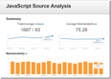











mocha
Developer cuts feature branch, writes tests, writes code, and submits for review
Check-in merged to Phabricator for pre-commit review by senior developers
Once code review is approved, git is used to push the code update to development branch
Jenkins begins automated build & deploy process
Grunt provides Automated task scripting
Grunt runs automated mocha behavior with chai assertions and unit tests via phantomjs & casperjs
JS Hint runs code quality tests and Plato runs code analyses
Passes Automated QA
Code artifacts, including applications are stored/retrieved in NPM and Bower
Feedback is passed to developers
Application readied for testing, metrics reported to CI
One deployed, application is automatically scanned by w3af and Gatling for security and performance
Code is deployed to environments (incl. dev/staging) by Jenkins via Docker
Code is packaged & readied for deploy by Grunt
Notes:
Close to nine in 10 (88%) now employ DevOps methodologies, and 42% strongly agree that DevOps is a top priority for their organizations. However, only 24% express strong satisfaction in the current state of their DevOps programs.

Slide 35
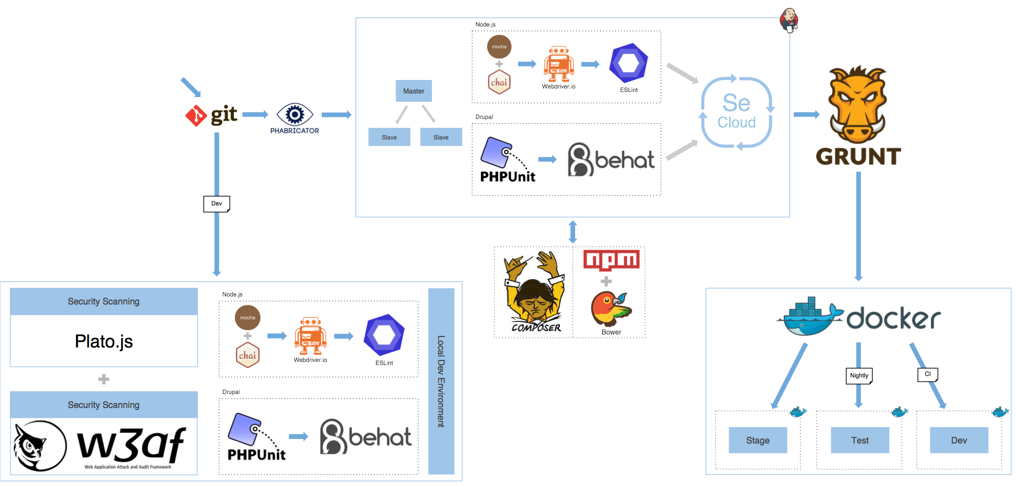
Notes:
Automated Deployment

Slide 36
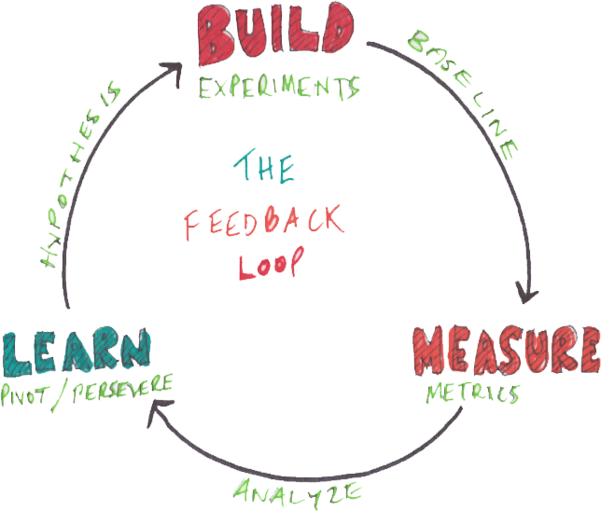

Slide 37
{breathe}

Slide 38


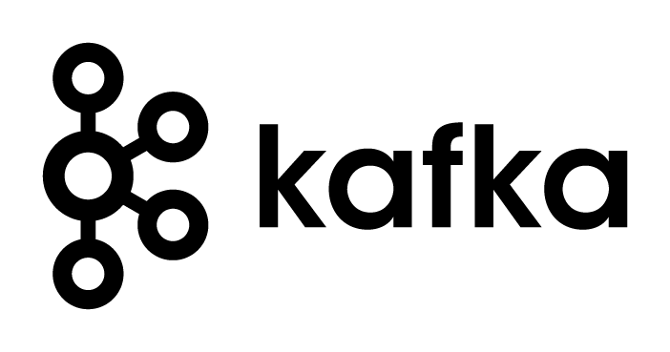

Going Quantum
… not all the way.
We want AI, but don’t need it
In the meantime...
Deep Learning, Blue Brain
Moaarrr Data (als NEW data)
Quantum Processing (Faster Concurrency)
Instant, Long Range Communication via entanglement (Lasers are cool, but…)
Notes:
Still room for biology
Alex Nugent: "When algorithms get intertwined with architecture – they become pretty strict and specific,”
Low powered Arduino’s that self-heal
memristors: based on neurons
http://knowm.org/

Slide 39
Thanks for your time! Questions?
Jesse Warden
@jesterxl
jesse@jessewarden.com
jesse.warden@accenture.com
http://jessewarden.com
Click Books Tab http://www.oreilly.com/pub/au/4997

